Slide 1

DealDrop
Scenario
PJ Adjei-Prempeh
Mervyn Jean-Baptiste
Stanley Dubois
Alexander
Zahid

Slide 2



Executive & Architecture Summary
The Problem: DealDrop faces massive traffic spikes (from 2,000 to 60,000 users in 5 minutes), resulting in slow page loads and checkout errors.
Solution: A three-tier architecture leveraging global edge caching, in-memory application caching, and auto-scaling compute power

Slide 3


Bottlenecks & Workload Categories
3 Major Bottlenecks
1. Front-End Compute: Fixed server capacity cannot handle a 3,000% user increase in minutes.
2. Database Locking: High read-to-write ratios (25:1) will overwhelm a single database instance during checkouts.
3. Global Latency: Customers in Europe and Asia (60% of traffic) face slow speeds if all data is in one region.
3 Workload Categories
1. Static: Product images (change daily/weekly).
2. Read-Heavy Dynamic: Product listings and search results (can tolerate 30-second delay).
3. Write-Heavy/Consistent: Checkout and inventory (must be current/accurate)

Slide 4


Compute Scaling and Elasticity Design
• Amazon EC2 (Elastic Compute Cloud): Provides the highly configurable virtual servers to host the three-tier web application and checkout logic.
• Elastic Load Balancing (ALB): An Application Load Balancer operates at OSI Layer 7 to distribute incoming HTTP/HTTPS traffic across multiple targets. This ensures that no single EC2 instance is overwhelmed during the DealDrop Event.
• Amazon EC2 Auto Scaling (ASG): Manages a collection of instances as a group to perform Scaling Out (adding servers) during traffic bursts and Scaling In (removing servers) during normal hours to control costs.
◦ Scaling Signals: We should monitor Average CPU Utilization and ALB Request Count Per Target to trigger scaling actions before capacity is reached.
◦ Multi-Availability Zone (AZ) Placement: By spreading instances across different AZs, we ensure business continuity; if one AZ fails, the ALB routes traffic to healthy instances in other zones.
◦ Warm-up: Warm Pools of pre-initialized instances are used to decrease latency for the application's sharp 3–5 minute ramp-up time.

Slide 5

Cache Design
Layer 1: Edge Caching (Amazon CloudFront)
This Global Content Delivery Network (CDN) delivers static content (images, CSS, scripts) from edge locations closer to users in Europe and Asia.
Cache Freshness: Static assets use long Time to Live (TTL) values (days/weeks). We can use AWS Lambda to automate cache invalidation if marketing updates product images prematurely.
Layer 2: Application Data Caching (Amazon ElastiCache Redis)
This in-memory data store provides sub-millisecond latency for frequently accessed dynamic data.
Safe Data to Cache: Product details (excluding sensitive fields), category lists, and search filters are ideal for caching.
TTL Recommendations: Use 5 minutes for product details, 1 minute for inventory displays (for the listing page), and 1 hour for category lists.
Correctness: To prevent stale data from breaking checkout, the checkout workflow must bypass the cache and interact directly with the primary database for current inventory and pricing.

Slide 6

End-to-End Request Flow Narrative
1. Homepage Visit: A user in Europe enters dealdrop.com. Amazon Route 53 resolves the domain to the nearest CloudFront Edge Location. Static files like the logo and CSS are served directly from the edge cache.
2. Product Detail Page: The user clicks a product. The request goes through the ALB to an EC2 instance. The application checks ElastiCache (Redis) for the product details. If found (cache hit), the page loads instantly; if not (cache miss), the app fetches it from the database and updates the cache.
3. Add to Cart: The user adds an item. This request hits the EC2 application layer to manage the shopping cart session; this personal data is never cached for security.
4. Checkout: The user clicks checkout. The application bypasses all caches to ensure it uses the most current pricing and inventory counts from Amazon RDS. The EC2 instance confirms payment with an external service and records the transaction in the strongly consistent database.

Slide 7

Observability and Operations
CPUUtilization (EC2)
RequestCount (ALB)
CacheHitRate (CloudFront)
To signal when the ASG needs to scale out.
To track the volume of incoming event traffic.
To ensure global edge caching is performing as expected.
EngineCPUUtilization (ElastiCache)
TargetResponseTime (ALB)
To monitor the health of the in-memory cache layer.
To detect rising latency during the peak 45 minutes.
• Alarms:
◦ Scale-Out Alarm: Triggered if Average CPU > 75% for 2 minutes; action: ASG adds instances.
◦ Cache Miss Alarm: Triggered if Cache Hit Rate < 50%; action: Notify team of a potential "cache stampede".
◦ Error Rate Alarm: Triggered if HTTP 5xx Errors > 1%; action: Investigate database or application failures.

Slide 8
Failure and Risk Analysis (Example Scenario)
Scenario | What Breaks | Impact Limitation | Operational Signal | Corrective Action
1. One AZ Unreachable | EC2 instances and RDS standby in that zone stop responding. | ALB health checks route traffic to healthy zones; RDS Multi-AZ performs auto-failover. | CloudWatch Alarm for UnHealthyHostCount or reduced capacity. | ASG automatically launches new instances in remaining healthy zones.
2. Traffic Doubles Forecast | CPU saturation; current fleet cannot handle 60k users, causing rising 5xx errors. | Auto Scaling aggressively adds instances based on CPU thresholds. | CloudWatch Alarm for CPUUtilization > 75% or high request counts. | Manually increase ASG MaxSize and add temporary RDS Read Replicas.
3. Cache Layer Unavailable | RDS becomes overwhelmed by the sudden 25:1 read-to-write ratio shift. | App "fails open," fetching data directly from the DB to maintain availability. | CloudWatch Alarm for a sharp drop in CacheHitRate. | Provision additional RDS Read Replicas to handle direct read load until cache is restored.
4. Stale Prices (Long TTL) | Users see outdated pricing (>5 mins old), leading to customer complaints. | Checkout workflow bypasses all caches to use 100% current RDS data. | CloudWatch Synthetics canary detects mismatch between cache and origin. | Manually clear ElastiCache or trigger a CloudFront Invalidation via Lambda.
•

Slide 9
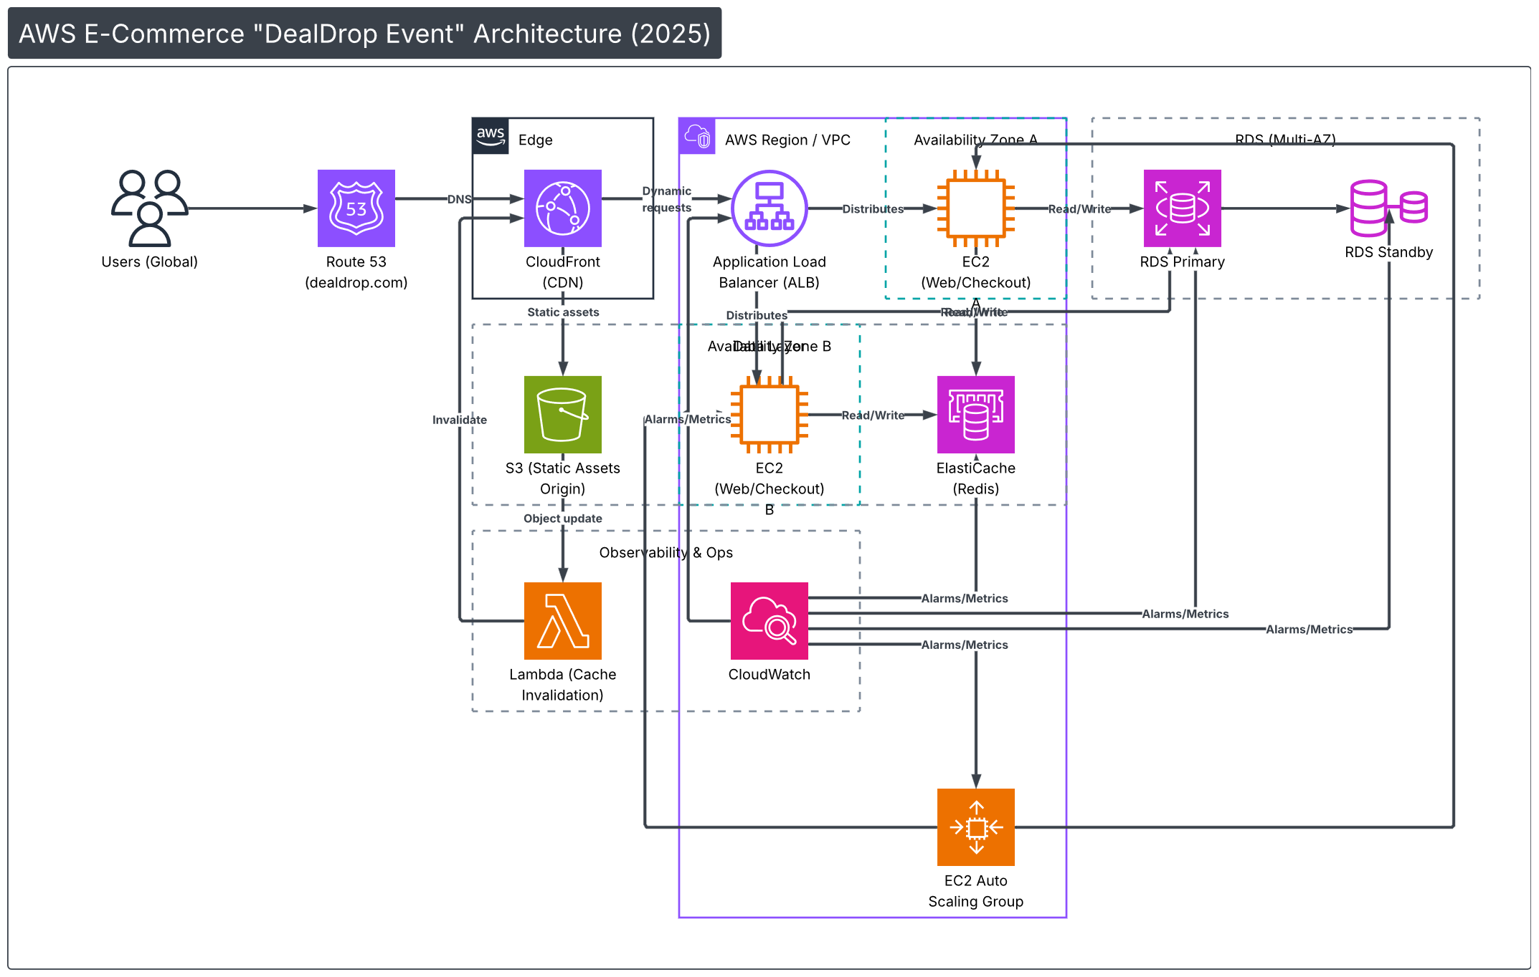
AWS E-Commerce "DealDrop Event" Architecture (2025)
Internet / Users
Edge
AWS Region / VPC
Availability Zone A
RDS (Multi-AZ)
DNS
Dynamic requests
Distributes
Read/Write
Users (Global)
Route 53
CloudFront
Application Load
EC2 (Web/Checkout)
RDS Primary
RDS Standby
(dealdrop.com)
(CDN)
Static assets
Balancer (ALB)
Distributes
A
RRe ea ad d/ /WWr ri t i et e
AvaiDlaabtiali tLya Zyeorne B
Invalidate
Alarms/Metrics
Read/Write
S3 (Static Assets
EC2 (Web/Checkout)
ElastiCache
Origin)
Object update
(Redis)
B
Observability & Ops
Alarms/Metrics
Alarms/Metrics
Alarms/Metrics
Alarms/Metrics
Lambda (Cache
CloudWatch
Invalidation)
EC2 Auto
Scaling Group

